Slide 1


Assignment #1
Do Great NBA Players Make Their Teammates Better?
Group 15:
Sai Prem Chand Reddy Narreddy
Nicholas Hamby

Slide 2

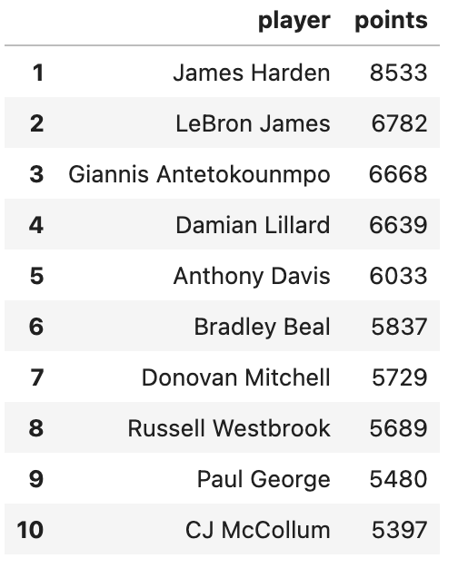
Who Are The Top Players?
Use data from 2017-2018, 2018-2019, and 2019-2020 seasons.
The primary objective of basketball is to score points.
Therefore, players that score the most points are the top NBA players.
Top scorers face double team coverage and spend the most time on court.

Slide 3
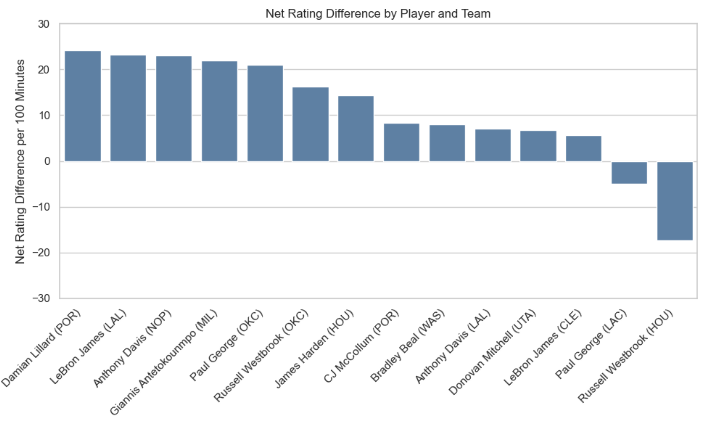
On/Off Court Net Rating by Minutes
We redefine net rating as a team's point differential per 100 minutes of game time.
Net rating difference is the net rating of the team with the star player on the court minus net rating of the team with the star player off the court.
Damian Lillard, as the star player on the Trailblazers, attracts a lot of defenders.
Therefore, when Dame is not on the court his teammates struggle with the increased pressure.

Slide 4
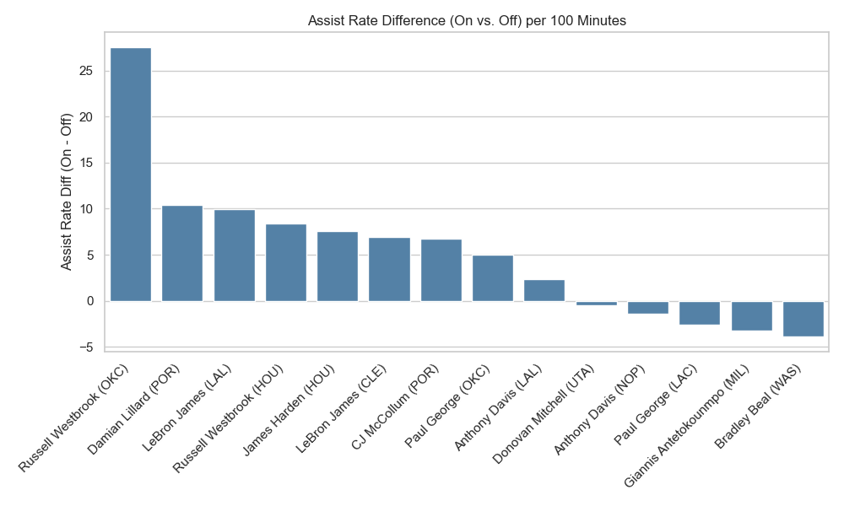
Comparing assist rates when a star player is on and off the court can help tell us is they are indeed making their teammates better.
Russell Westbrook’s teammates on the Thunder experienced, on average, 27 more assists than without him per 100 minutes.
Thus, Westbrook enabled his teammates to take more scoring opportunities, making them better players.
Assist Rate Difference

Slide 5
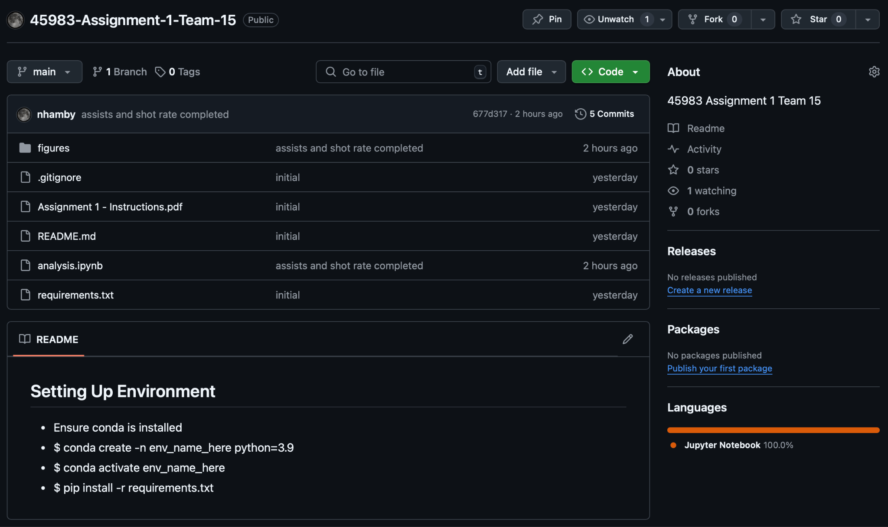
Appendix
GitHub Repo Link: https://github.com/nhamby/45983-Assignment-1-Team-15

